Slide 1
Algorithms errors biases

Slide 2
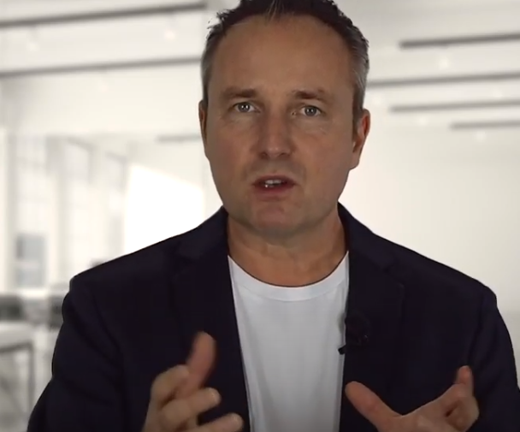
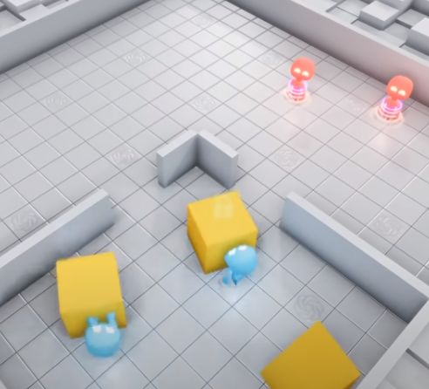
https://www.bbc.co.uk/news/av/technology-59294258
https://www.youtube.com/watch?v=AXgjEW2nA9I
https://www.youtube.com/watch?v=kopoLzvh5jY
https://www.youtube.com/watch?v=KXJSjte_OAI

Slide 3
https://repl.it/@JohnGlazebrook/caesar-test

